Slide 1
Meet the company
http://detaelisdevices.com

Slide 2
What is the company
Certified - Recognized manufacturer of diagnostic & therapeutic bioresonance devices
Headquarters: Moscow, Russian Federation
Construction of bioresonance devices by the year 1992, under the name «ELIS»
Activity with existing corporate form and name: 2 years
17 years of research, studies and clinical trials in hospitals and university clinics of the Russian Federation
More than 70,000 associates in Asia and Europe
Rapidly growing in Europe last year

Slide 3
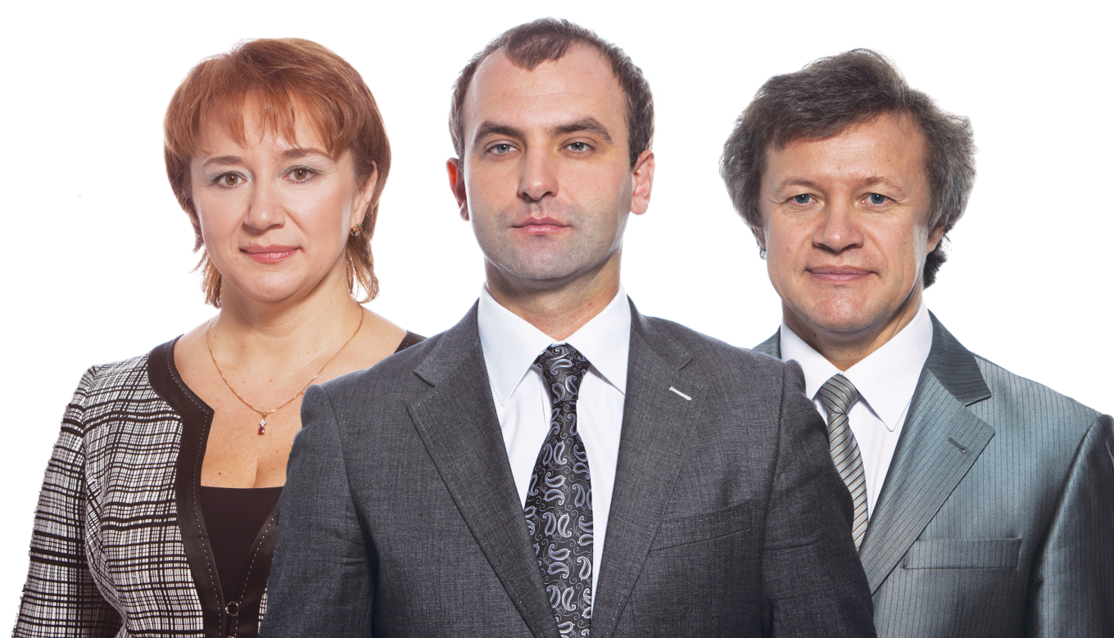
Founders of the company
Sergei Konoplov - Designer of the devices. Radio engineering graduate from the University of Energy of the Russian Federation. Doctor of Medicine with postgraduate studies in Germany.
Roman Novikov - Promoter & PR
Tatiana Konoplova - Responsible for the financial management

Slide 4
Medals awarded to
Medal of the Russian Academy of Sciences for her contributions to the company to improve the health of Russia's national
Medal for the production of the best 1000 Russia
Medal of Ministry of Health of the Russian company's contribution to the national health
Medal "LL Metsnikof "for outstanding scientific work of the company in the field of microbiology, epidemiology and treatment of infectious diseases

Slide 5
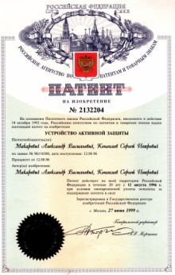
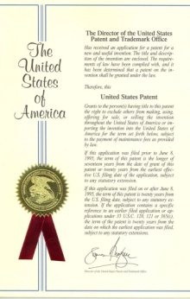
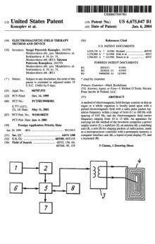
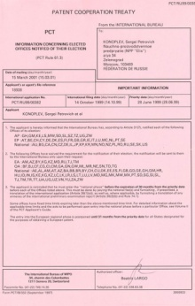
Patents
Patent issued to Alexander and Sergei Makarovits Konoplov the Russian Patent & Trademark Office on 06/27/1999
Patent issued to Tatiana and Sergey Konoplova Konoplov the Russian Patent & Trademark Office on 27/03/2001
Patent issued to Alexander and Sergei Makarovits Konoplov the Russian Patent & Trademark Office on 10/07/1999
Patent issued to Victor Tsernich and Vitaly Souchoroukov the Russian Patent & Trademark Office on 27/06/2006

Slide 6
Patents
Patent issued to Victor Tsernich and Lyudmila Souchoroukova the Russian Patent & Trademark Office on 20/03/2003
Patent issued by the Patent Office and Trademark Office U.S. Sergei Konoplov
International patent issued to Sergei Konoplov valid in 72 countries

Slide 7
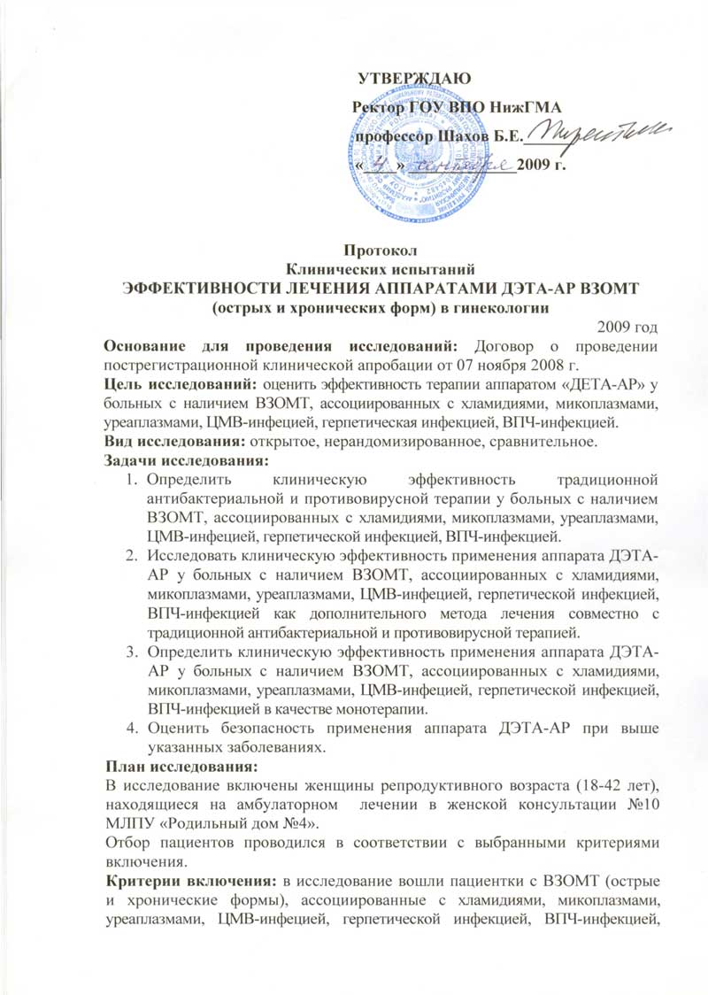
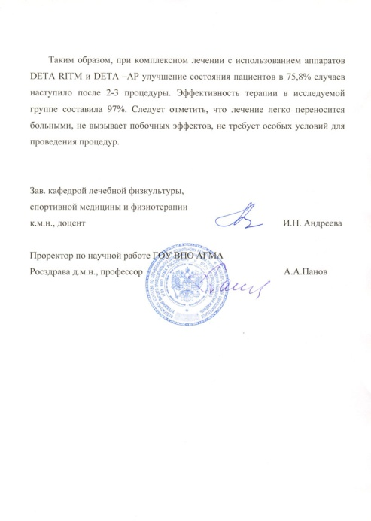
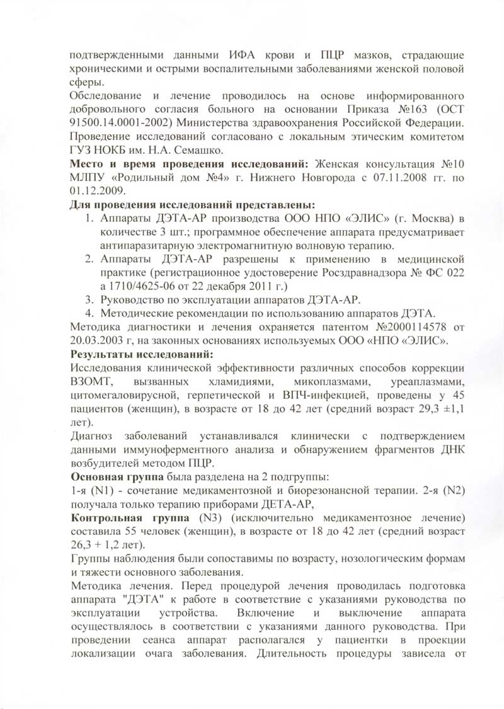
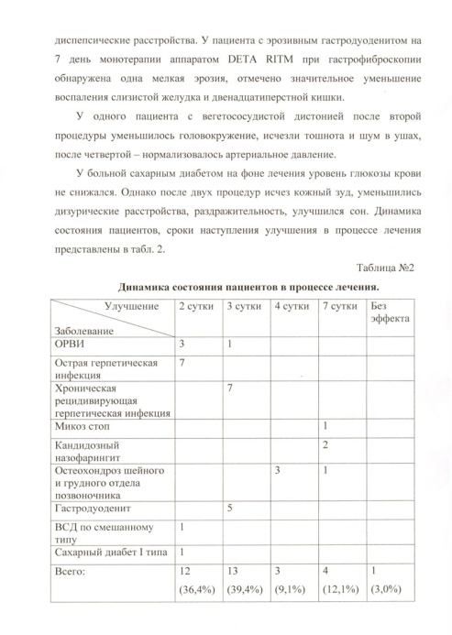
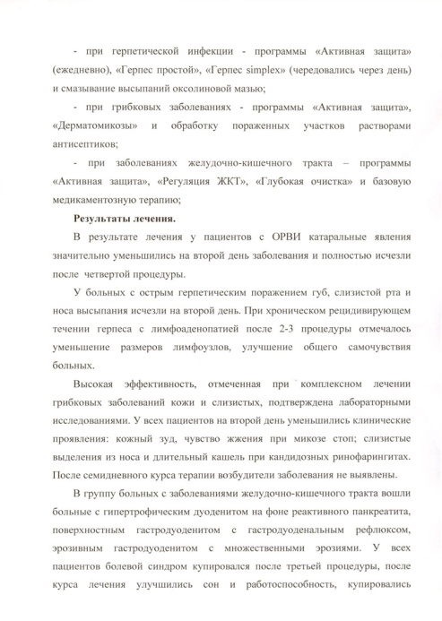
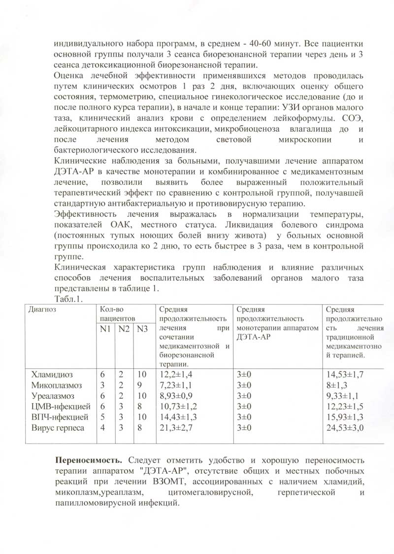
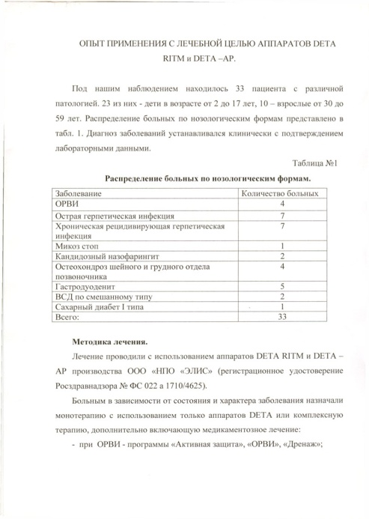
Clinical trials and research
More than one hundred (100) clinical studies and research in thousands of patients over the last twenty years, demonstrate the effectiveness of the devices Deta-Elis.

Slide 8
Bioresonance and
"Resonance" is the phenomenon of forced oscillation, in which the frequency of the exciter coincides with the frequency of the oscillator

Slide 9
Bioresonance and
"Bio-resonance" is the process of coordination in parasites, viruses and microorganisms, until full and final decomposition

Slide 10
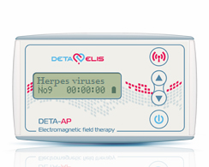
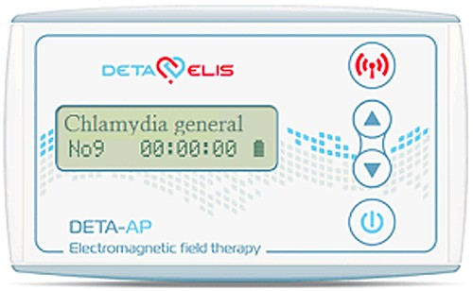
Bioresonance Therapeutic devices
Deta-Ap
Conducting antiparasitic therapy
1500 available frequencies
13 or 20 preloaded frequencies, depending on the type of device
Possibility of reprogramming the device unlimited times
Requires 2 AA rechargeable batteries
The particular device can address: Virus - 90 species, Bacteria - 91 species, Fungi - 61 species Protozoa - 31 species and Helminths - 33 species

Slide 11
Bioresonance Therapeutic devices
Deta-Ap
The device has preinstalled the following 20 frequencies from 1500 available:
S/N | Frequency | Possible symptoms
1 | Detoxification | Elimination of toxins from the body
2 | Ascaridida | Worms, enteroviasi, nausea, teeth grinding, headaches, lack of appetite, abdominal distension
3 | Enterobius | Worms, enteroviasi, itching anus, irritability, depression
4 | Giardia | Abdominal pain, constipation, diarrhea, allergy, pancreatitis, hepatitis, nefrokykloforiki disease, anemia
5 | Helicobacter Pylori | Gastric and duodenal ulcer, gastritis, heartburn, nausea, dry mouth, eructation (belching)
S/N | Frequency | Possible symptoms
6 | Candida (fungus) | Fungi, fungal infections, dysviosis, fungal infection, nephrolithiasis, pyelonephritis, meningitis
7 | Trichomonas | Pain, burning sensation when urinating, itching, irritation, prostatitis, cystitis, infertility
8 | Chlamydia | Inflammation of the genital tract, fallopian tubes, urethritis, infertility, salpingitis, abdominal pain
9 | Mycoplasma | Groin pain, inflammation, prostatitis, cystitis, pyelonephritis, miscarriages, infertility
10 | Staphylococcus | Tonsillitis, wound suppuration, furuncle (boil), styes (abscess in the eyelid), influenza, sepsis, poisoning, enterocolitis
S/N | Frequency | Possible symptoms
11 | Streptococcus | ENT-organs, sore throat, tonsillitis, pneumonia, sinusitis, tonsillitis, lymphadenitis, otitis media, skin rash, purulent arthritis, rheumatism, kidney disease, osteomyelitis, scarlet
12 | Escherichia coli | Gastroenteritis, diarrhea, dysviosis, cholecystitis, tracheitis, ENT, arthritis, adenoma
13 | Onychomycosis | Nail fungus
14 | HPV (Human papilloma virus | Warts, papillomas, condylomas, dysplasia and cancer of the cervix
15 | Herpes | Itching, burning, pain, rash on the genitals and lips, skin blisters, infertility
S/N | Frequency | Possible symptoms
16 | Virus Epstein-Barr (EBV) (Feline infectious mononucleosis) | Lymphoma, fatigue, sore throat, sleep disturbances, depression, arrhythmia, allergy
17 | Cytomegalovirus - CMV | Malaise, fatigue, headache, inflammation of the liver, spleen, pancreas, kidneys
18 | Flu respiratory system | Fever, chills, weakness, headache, symptoms of bronchitis and rhinitis
19 | Antiseptic program | Infections including unidentified infections, inflammation, swelling, pain, redness
20 | Inflammation | Various kinds of inflammation, redness, swelling, fever, colds

Slide 12
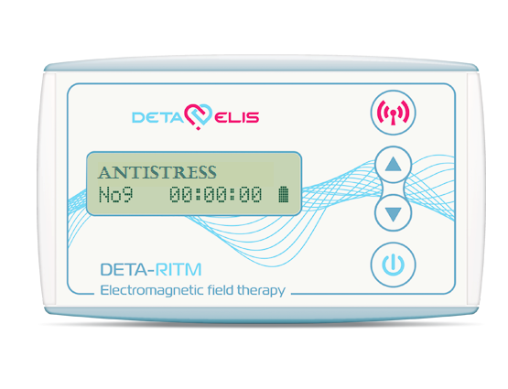
Bioresonance Therapeutic devices
Deta-Ritm
Restores the organs to normal healthy frequency
1500 available frequencies
13 preinstalled frequencies
Possibility of reprogramming the device unlimited times
Requires 2 AA rechargeable batteries

Slide 13
Bioresonance Therapeutic devices
Deta-Ritm
It is clinically proven that Deta Ritm devices successfully treat the following diseases:
diseases of the cardiovascular system (hypertension , angina pectoris, tachycardia, edema , varicose veins , etc. )
endocrine disorders
kidney diseases ( pyelonephritis , renal colic , etc. )
urological diseases ( prostate adenoma , prostatitis , etc. )
gastrointestinal diseases
respiratory diseases ( bronchitis , asthma , pulmonary edema , pneumonia , etc. )
headaches of different origins
diseases of the central and peripheral nervous system
gynecological diseases
tonsillitis , laryngitis , otitis media , and many other diseases

Slide 14
Bioresonance Therapeutic devices
Deta-Cosmo
The first device cosmetology series combines Deta cosmetological and therapeutic action
13 preinstalled frequencies
Dual mode: Electromagnetic therapy and quantum therapy. First, the device Deta-Ritm 15 treats diseases of organs and other
Accessory quantum eliminates skin imperfections caused by diseases of these organs.
Easy to use with detailed application instructions

Slide 15
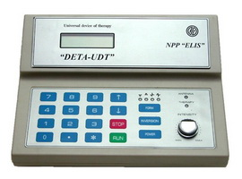
Bioresonance Therapeutic devices
Deta-UDT
Medical treatment device
Three methods of treatment: acupuncture, electromagnetic and quantum therapy.
Can be used by professionals in homeopathy clinics, reflexotherapy, physiotherapy, holistic medicine and rehabilitation clinics.
Possibility of applying high precision frequency (up to the fourth decimal place).
Special antenna enables both the overall impact on the whole body, and in each particular organ through a special viewing area of the body.
Extended frequency range from 0,1 Hz to 100 Hz

Slide 16
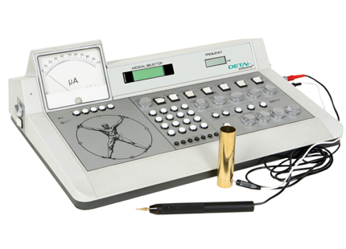
Bioresonance diagnostic & therapeutic device
Deta-Professional
Diagnosis with bioresonance method
Achieve universal examination of the body of the patient
Possibility diagnosis of disease, and the stage of the cause
Fully reliable diagnosis, fast and economic
Applicability of five therapies: Treatment with electroacupuncture, electromagnetic therapy, quantum healing, bioresonance therapy, combination therapy

Slide 17
Programming Software
Therapy 8
Mini USB Device – software for programming Deta-Ap and Deta-Ritm devices
More than 3,000 available frequencies
Function in Windows
UPnP (Universal Plug and Play) - No installation required on the computer
Programmable in five national languages ​​(Russian, English, French, German and Spanish)
Automatic device recognition - plug in and programm
Upgrading via the Internet at the touch of a button

Slide 18
Cooperation with
For the Doctor
For Individuals

Slide 19
The Way to financial independence
MLM
EMPLOYEE
BUSINESS
PRODUCTION
INVESTMENTS
- Professional development
- Free time
- Unlimited income
- Minimum investment of money
- Training & Support

Slide 20
System 8
SYSTEM TRAINING FOR PARTNERS
Phase 3: TOP LEADER LEVEL
Author of life
Knowledge of life
The fifth element
Phase 2: LEADER LEVEL
Evolution
Incite
Step by Step
Phase 1: BASIC LEVEL
Step Up
Fast Track

Slide 22
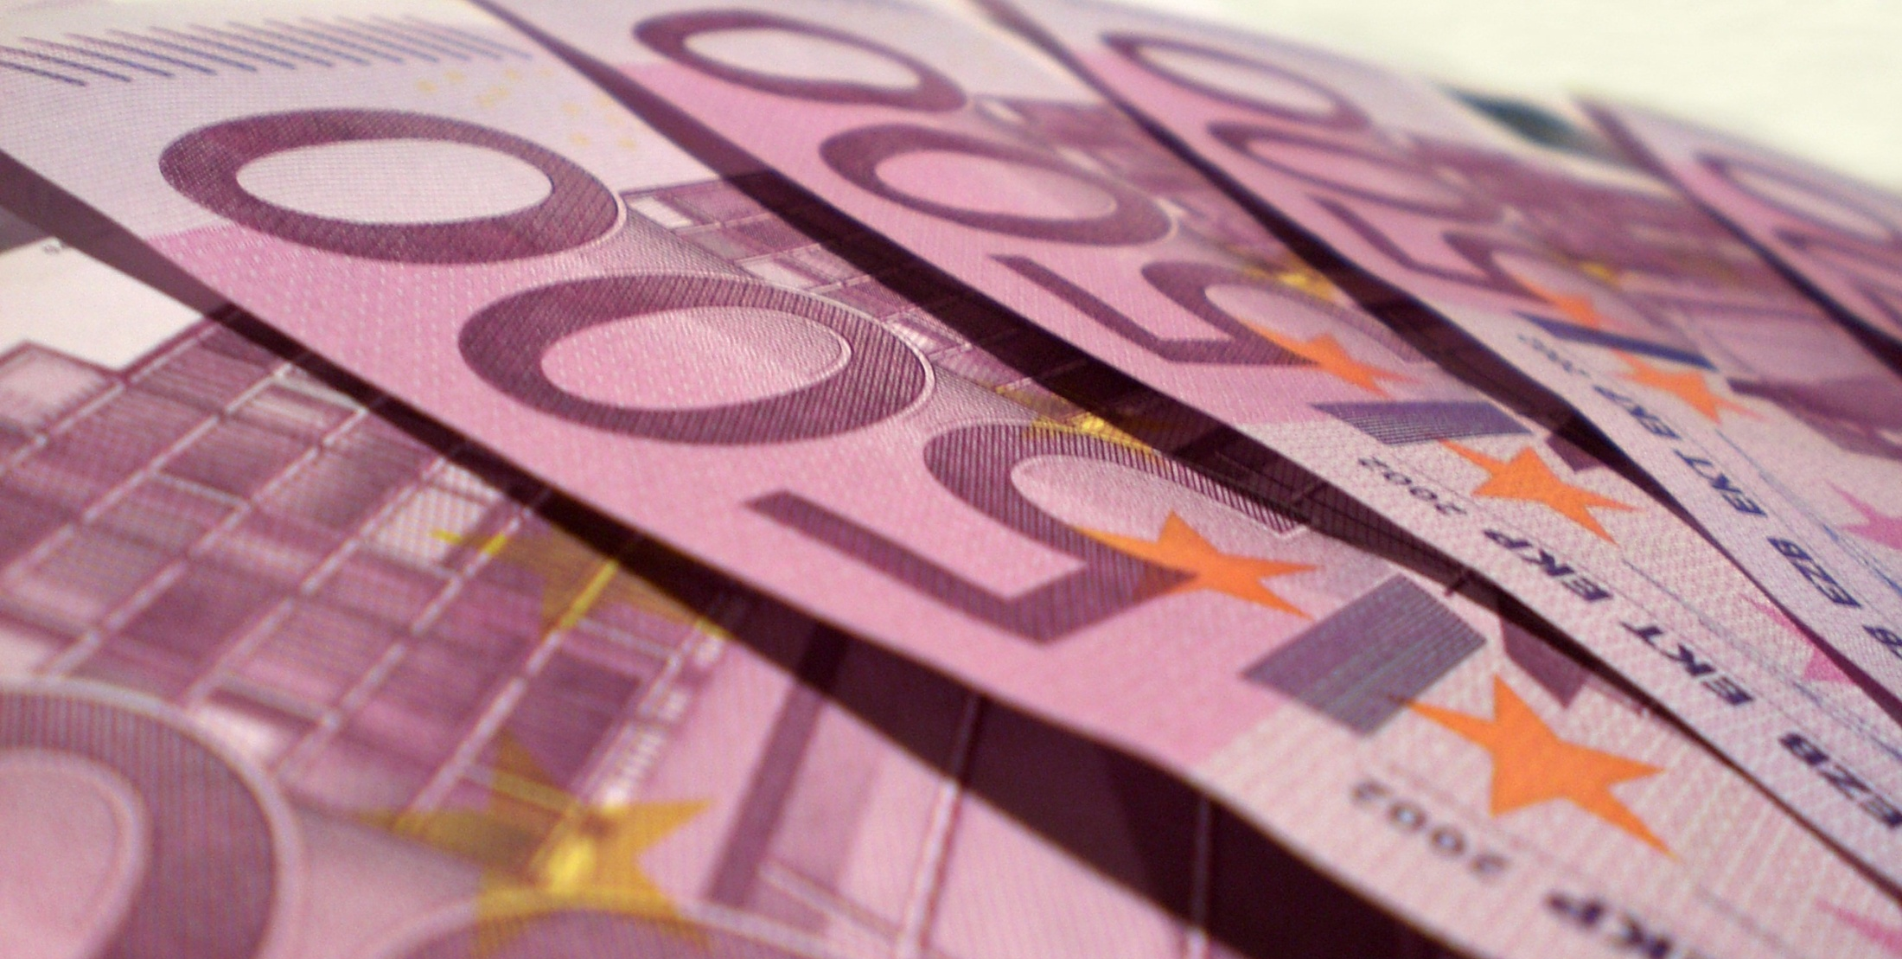
Professional development
STAR
MASTER
BRONSE MASTER
SILVER MASTER
GOLD MASTER
PLATINUM MASTER
SAPPHIRE MASTER
RUBY MASTER
EMERALD MASTER
DIAMOND MASTER
BLACK DIAMOND MASTER

Slide 23
Required Steps to conquer levels
Platinum Master → 250 Steps
Bronze Master → 15 Steps
Master → 1 Step
Gold Master → 100 Steps
Silver Master → 45 Steps
1 Step = 1000 credits

Slide 24
Required Steps to conquer levels
Black Diamond Master → 10.000 Steps
Ruby Master → 1.000 Steps
Sapphire Master → 500 Steps
Diamond Master → 5.000 Steps
Emerald Master → 2.500 Steps
1 Step = 1000 credits

Slide 25
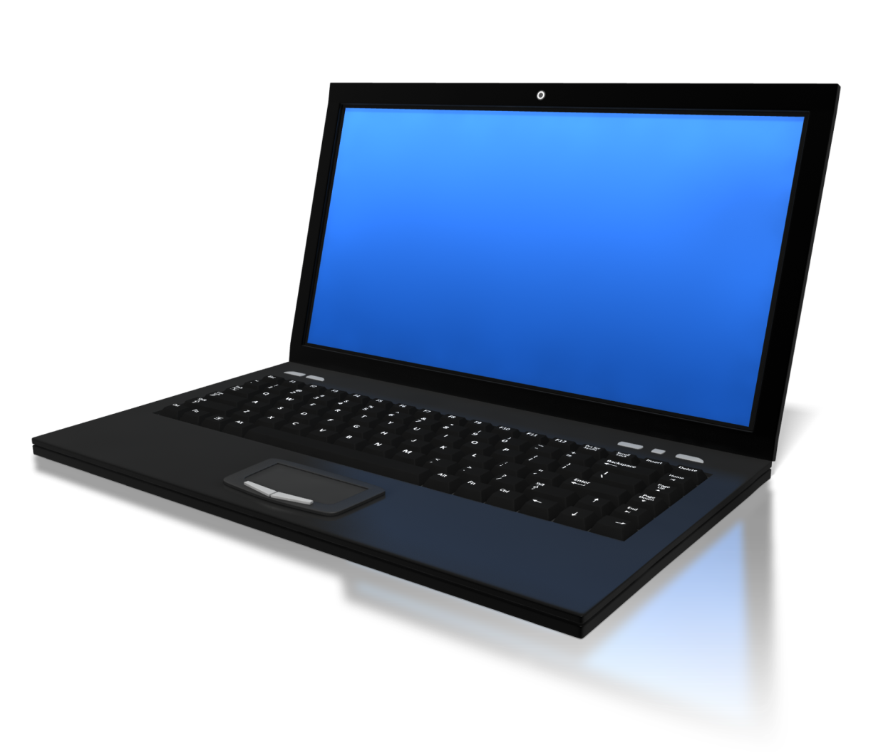
Sapphire Master
Income more than 37.500 € and get a laptop

Slide 26
Sapphire Masters
Income: More than 37.500 €

Slide 27
Sapphire Masters
Income: More than 37.500 €

Slide 28
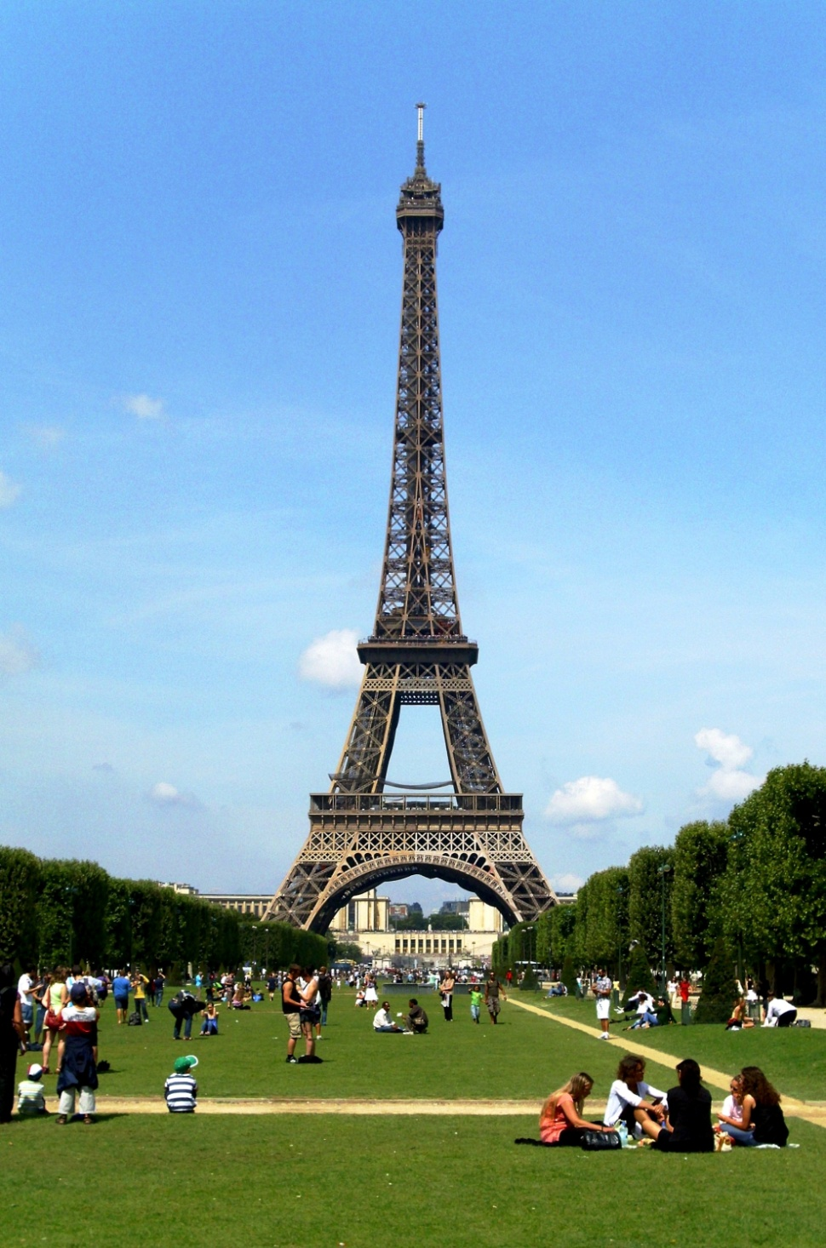
Ruby Master
Income more than 75.000 € and get a trip to Paris

Slide 29
Ruby Masters
Income: More than 75.000 €

Slide 30
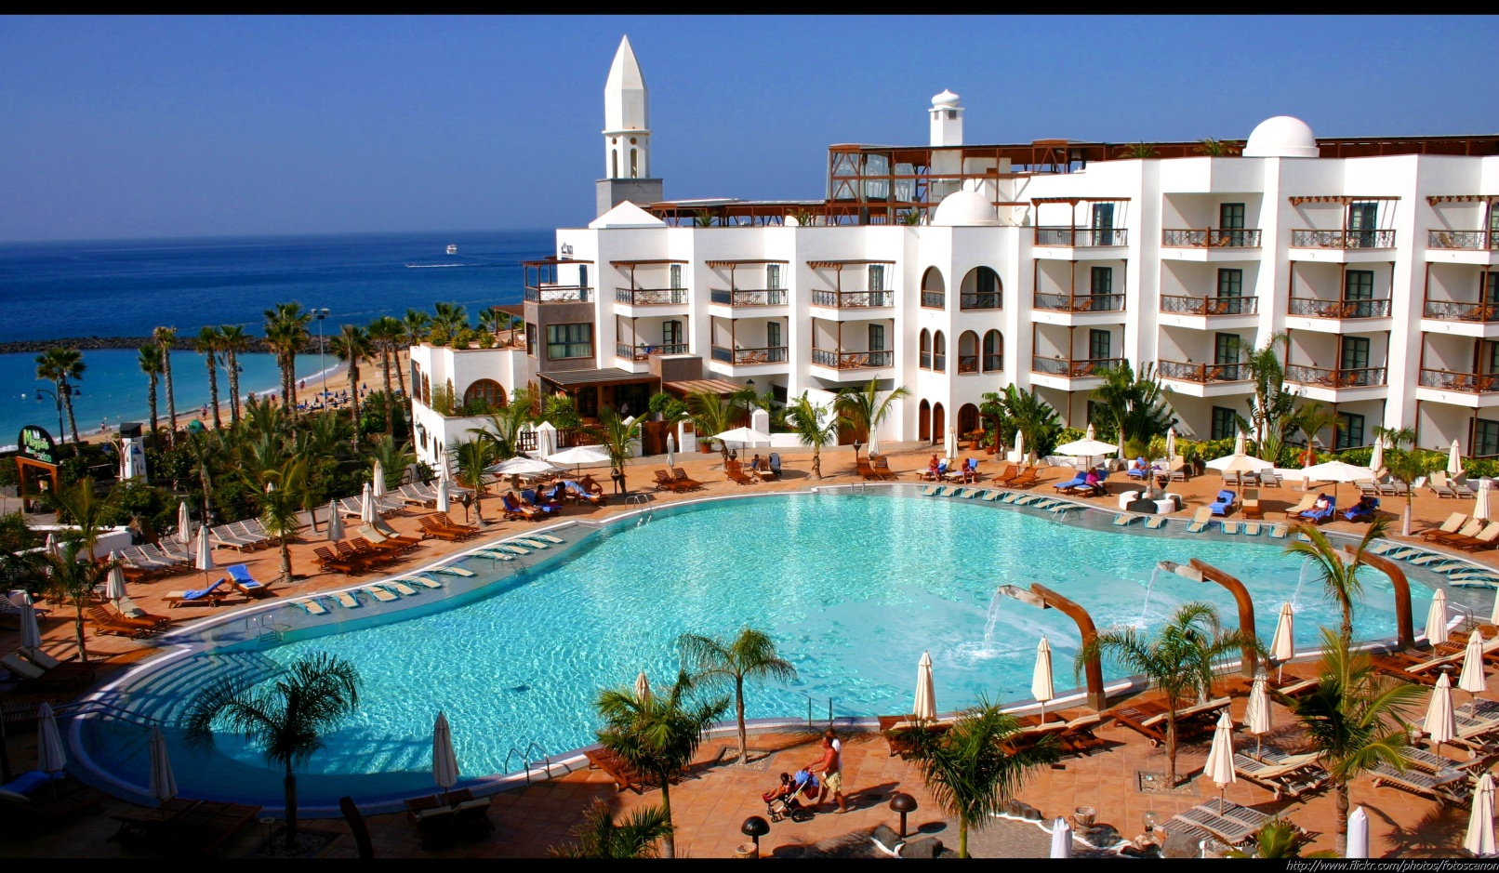
Emerald Master
Income over 187.500 € and get a trip to the Canary Islands

Slide 31
Emerald Masters
Income: More than 187.500 €

Slide 32
Diamond Master
Income over 375.000 € and get a trip to the Maldives

Slide 33
Diamond Masters
Income: More than 375.000 €

Slide 34
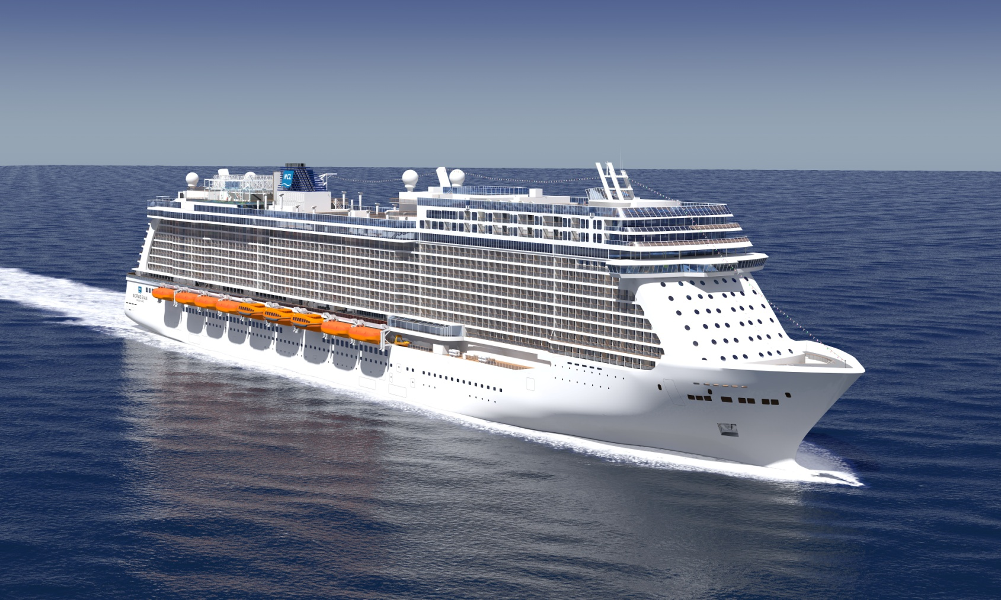
Black Diamond Master
Income over 750.000 € and gift round the world cruise

Slide 35
Step 1
Registration at company
Step 2
Buy products worth 330 corporate units
Step 3
Acquisition of information worth 50 corporate units
The first steps

Slide 36
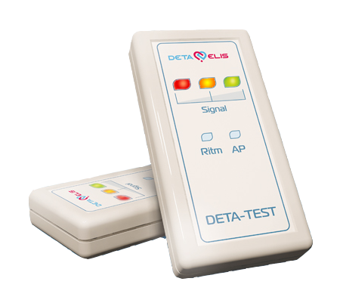
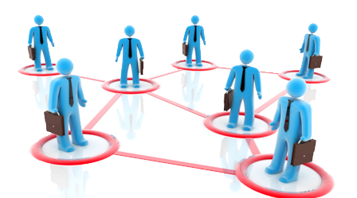
TYPES OF INCOME
Product promotion Rewarding
Star Bonus rewarding
Network development Rewarding

Slide 37
Product promotion rewarding
Product | Price | Profit
Programming device Therapy 8.0 | 250€ | 37,50€
Therapeutic device Deta-Ritm 13 | 400€ | 62,50€
Therapeutic device Deta-Ap 13 | 400€ | 62,50€
Therapeutic device Deta-Ap 20 | 450€ | 75,00€
Diagnostic devices for doctors D-104 και D-113 | 2.200€ | 225,00€
Diagnostic and therapeutic device for doctors Deta-Professional | 7.700€ | 750€
Cosmetology device Deta-Cosmo | 525€ | 75,00€
Therapeutic medical device Deta-UDT | 675€ | 82,50€

Slide 38
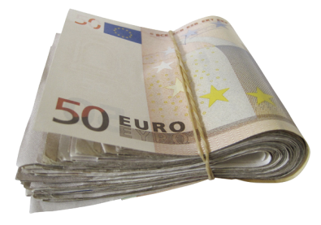
Star Bonus rewarding
You
37,50€
Star
Help your partner to become a Star * in seven days and get 37,50 € bonus
left
right
“Star” becomes the partner who invited individually into the business one person in his left and right teams within seven days.

Slide 39
Points of products
Product | Points
Programming device Therapy 8.0 | 125
Therapeutic device Deta-Ritm 13 | 175
Therapeutic device Deta-Ap 13 | 175
Therapeutic device Deta-Ap 20 | 200
Diagnostic devices for doctors D-104 και D-113 | 900
Diagnostic and therapeutic device for doctors Deta-Professional | 3000
Cosmetology device Deta-Cosmo | 250
Therapeutic medical device Deta-UDT | 300
1 credit = 1 corporate unit = U.S. $ 1

Slide 40
Rewarding network development (Team Bonus)
Sponsor
You
1
2
1 Step = 1000 points = 100 corporate units 100 corporate units =75€

Slide 41
http://detaelisdevices.com
Health - Effectiveness-Innovation - Success

